Slide 1
Milk Moscow
club I music gallery

Slide 2
Milk Moscow: general info
MILK MOSCOW - new conceptual area, which is located in the on the plant floor of former manufactory in the center of Moscow, in the region m. “The street of 1905”
Loft Club with capacity on the order of 4 000 people - new type of universal club space, it’s uniting concert hall and dance floor.
Milk Moscow - this celebration of functional and qualitative comfort.
It’s the first venue in Moscow with vigorous stylistics Loft space, that can hold different activities: conferences, dance festivals and corporate events.
The primary color of area - white, which makes it possible to change the color and light filling of entire hall (if necessary).

Slide 3
Milk Moscow: additional info
Location: 9, Sergey’s Makeeva str. Moscow . About 10 minutes on foot from “Street of 1905 year” Metro station
Description: Main dance floor: spacious hall with two circular bars, main scene
VIP balcony: convenient soft furniture, 3 bars
Small hall: hall -transformer, mobile bar
Capacity:
Main dance floor :
Banquet: 400 people
Stand-up meal : 2000 people
Seating chart : 500 people
Concerts: 2 500 people
VIP balcony :
Banquet: 300 people
Stand-up meal: 400 people
Seating chart : 200 people
Concerts: 500 people (incl. 99 landing places )
Small hall:
Banquet: 250 people
Stand-up meal: 400 people
Seating chart : 300 people
Concerts: 700 people

Slide 4
Milk Moscow: capability
Equipment: venue is equipped with modern light and sound
Kitchen: we can propose to you diversified menu. Our chief- cook will be able to satisfy any demands
Personnel: we have state of the basic service personnel such as:
cleaning service
check-room attendant,
hostess,
wait staff,
security
Backstage: backstage area equipped with 4 equipped make-up rooms, which can accommodate
20 artists + the separate entrance into backstage area from the street, parking for the artists
Additionally: separate entrance for VIP, possibility of organizing parking for 50 cars.

Slide 5
Milk Moscow: technique*
Audio equipment
YAMAHA M7CL-48ch (1)
Meyer Sound MICA (12)
Meyer Sound 700-HP (6)
Meyer Sound UPJ-1P (8)
Galileo 616 (1)
Meyer Sound USM1P (4)
Klark Teknik DN 360 (1)
Tascam MD-350 (1)
Meyer Sound MG-MICA (2)
KLOTZ (1)
Partner LM (1)
СhainMaster (4)
The lighting equipment
Coemar I-Spot 575 (14)
Coemar I-Spot 575 (5)
ColorBeam (9)
Martin Atomic 3000 (11)
Coemar I-Spot 150 (4)
ChainMaster (11)
Fresnel 2 k (4)
Truss 2m (42)
Hazer DF-50 (1)
Avolite Diamond 4 Elite (1)
Par 36 (8)
Par 64 (84)
StripLite (20)
* This equipment enters into “base” complete set with the lease. We have the possibilities to give any technical equipment on your demand.

Slide 6
Milk Moscow: operational experience
Started working in October 2009 Milk Moscow club had already hold such concert as:
Benny Benassi Live in Concert от Spongle крестного отца house музыки Pete Tong ATB Planet Funk Scooter Papa Roach Birthday party «Radio Maximum»
Olmeca Gold Fever
Red Snapper
Bad Religion
Iggy Pop
The Pouges
Gogol Bordello
And many-many others …

Slide 7
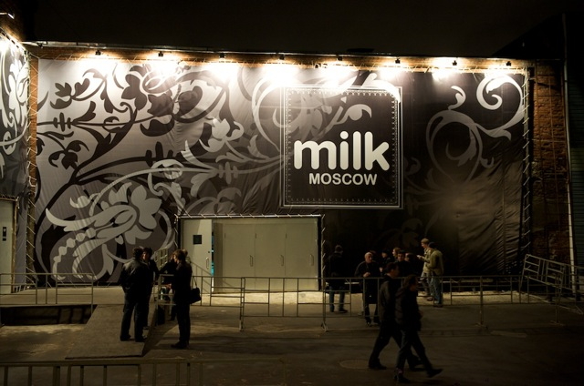
Milk Moscow: main entrance

Slide 8
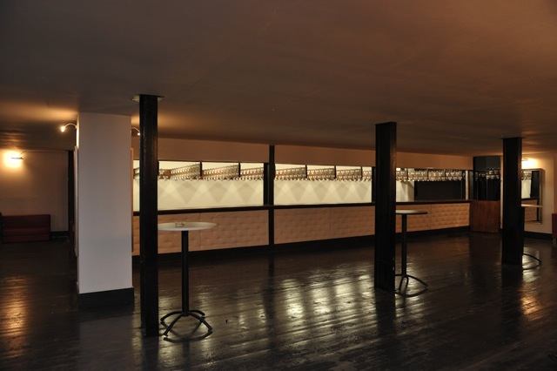
Milk Moscow: the cloakroom

Slide 9
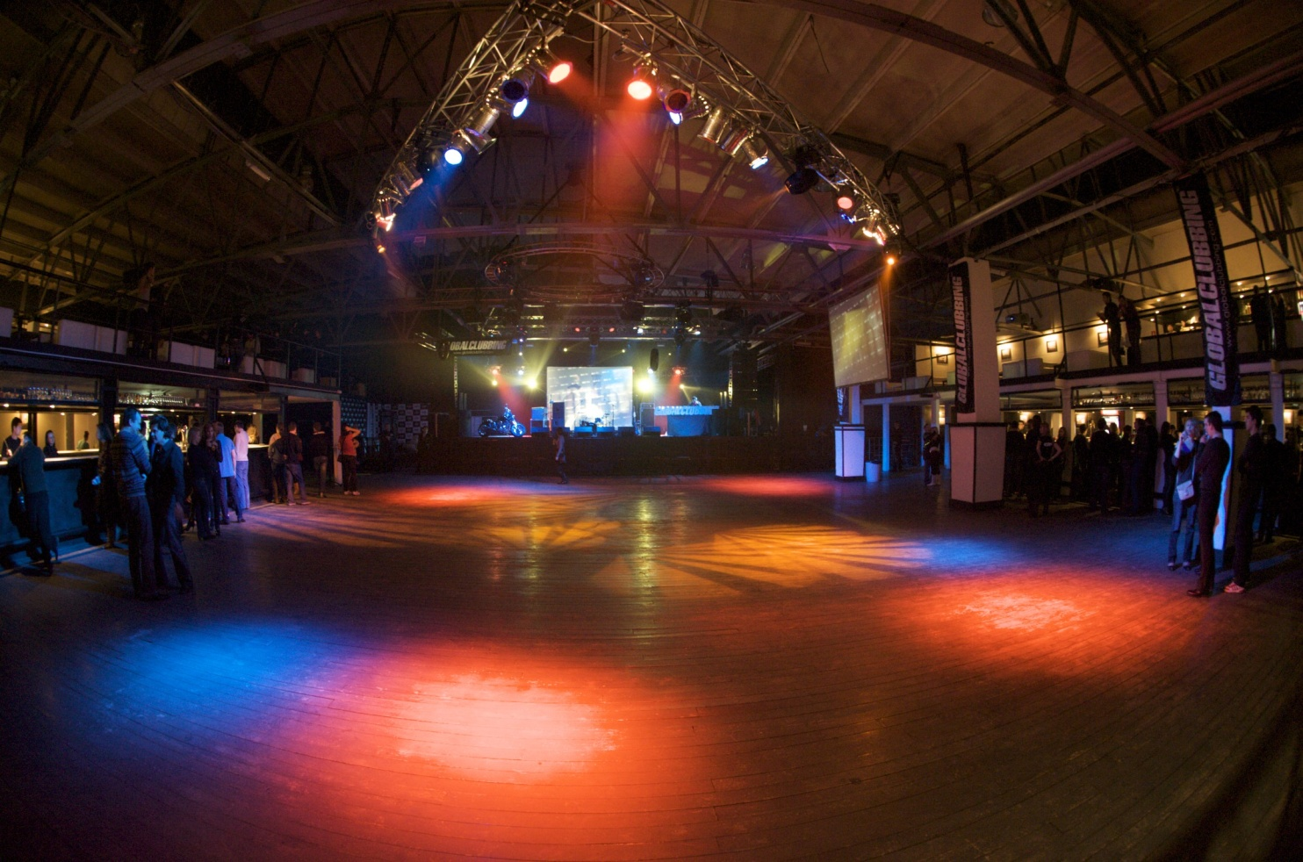
Milk Moscow: main stage

Slide 10
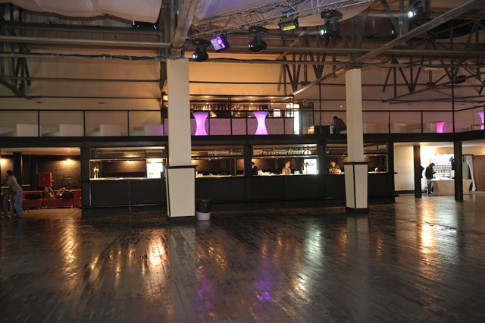
Milk Moscow: the bar

Slide 11
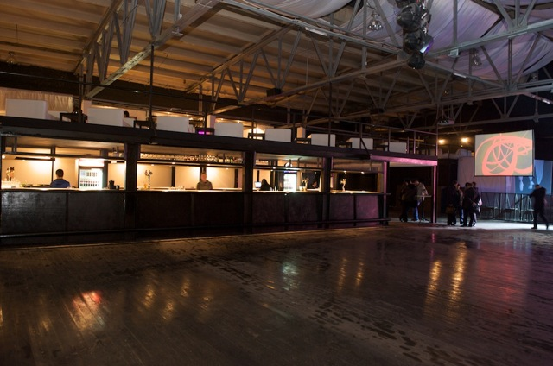
Milk Moscow: the bar

Slide 12
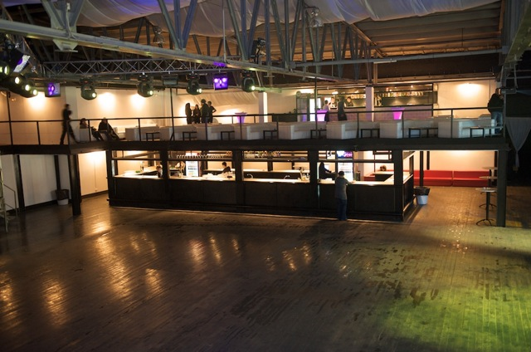
Milk Moscow: the bar

Slide 13
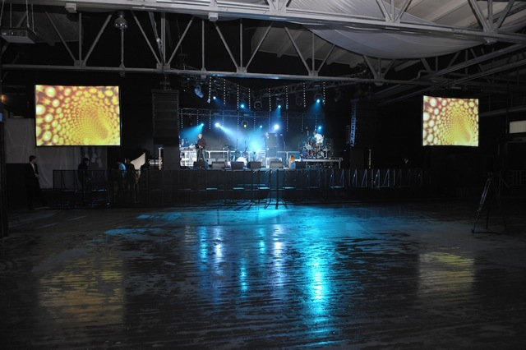
Milk Moscow: stage

Slide 14
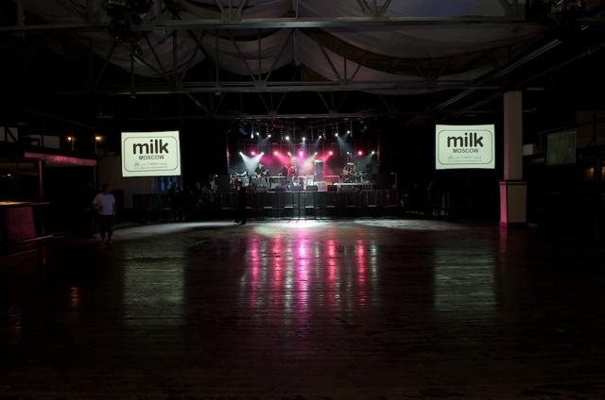
Milk Moscow: stage

Slide 15
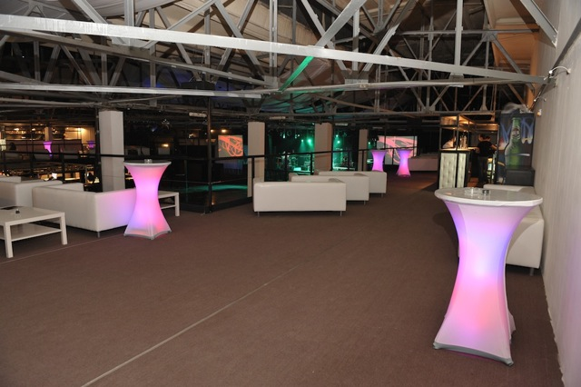
Milk Moscow: VIP zone

Slide 16
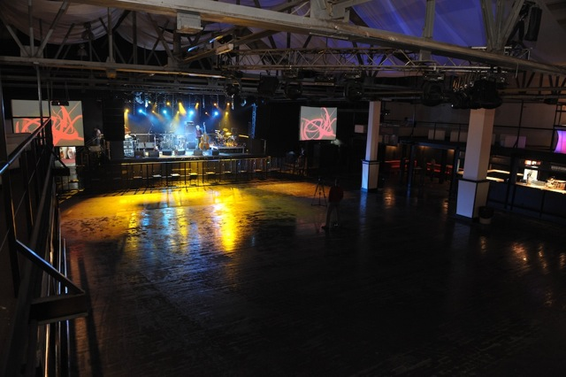
Milk Moscow: view from the VIP zone

Slide 17
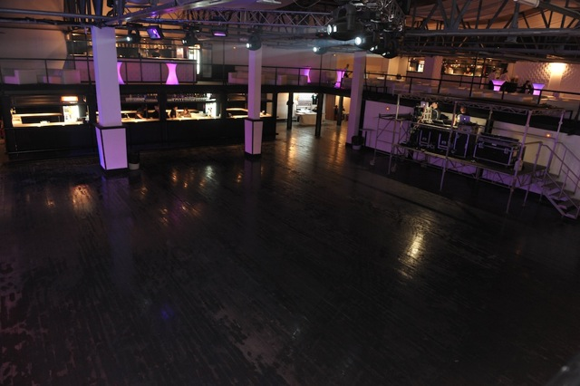
Milk Moscow: view from the VIP zone

Slide 18
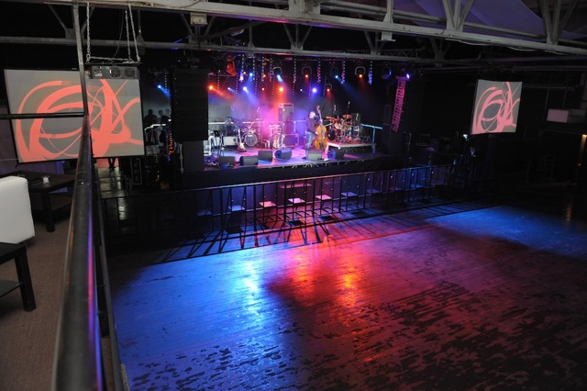
Milk Moscow: view from the VIP zone

Slide 19
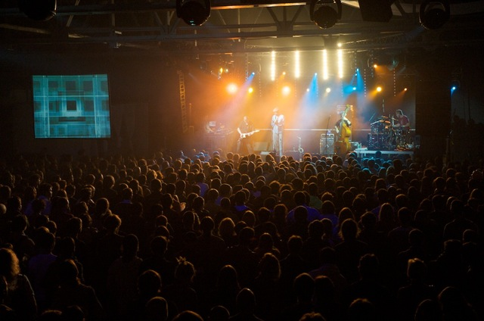
Milk Moscow: the event

Slide 20
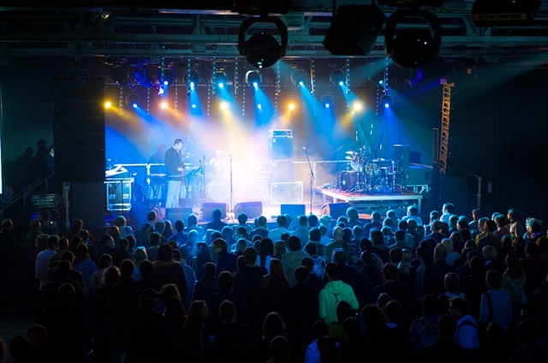
Milk Moscow: the event

Slide 21
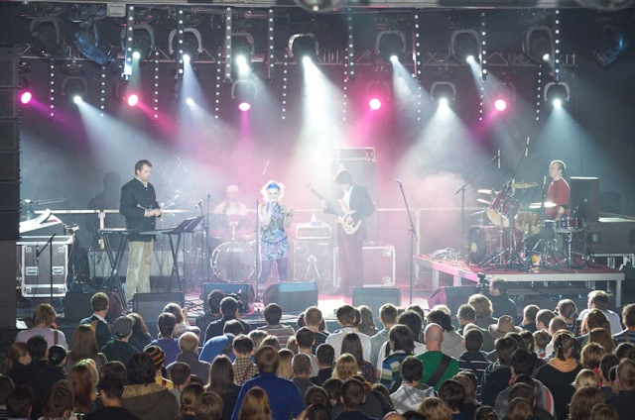
Milk Moscow: the event

Slide 22
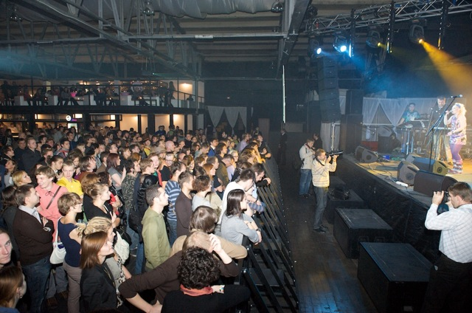
Milk Moscow: the event

Slide 23
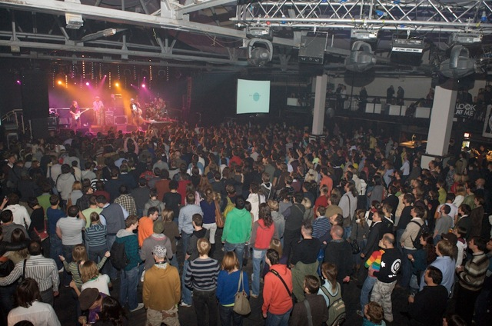
Milk Moscow: the event

Slide 24
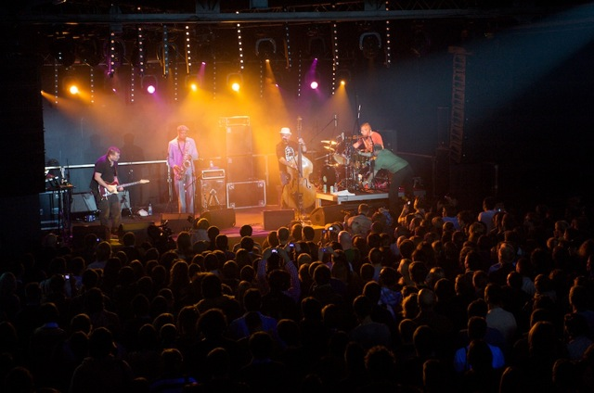
Milk Moscow: the event

Slide 25
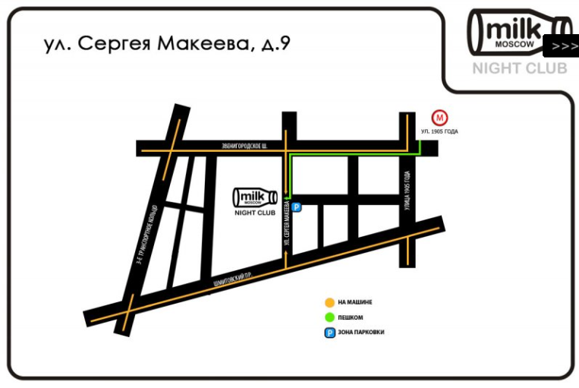
Milk Moscow: contacts
+7 495 726 0998
info@milkclub.ru
www.milkclub.ru

Slide 26
Milk Moscow
thank you!

